Slide 1


The Battle of Neighborhoods Hamza Enzo Safadi Coursera IBM Data Science Capstone

Slide 2
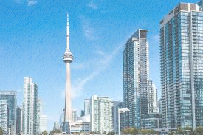
Presentation Subjects
1.1. The Introduction
1.1.1.Backgroud
1.1.2. Problem
1.2. The Data : The Workflow
1.2.2. Selecting Principal Components
1.2.3. Silhouette Score
1.2.4. Elbow Method
1.2.5 Cluster Visualization
3. The Conclusion

Slide 3
1.1. The Introduction – The Big Question
In this project, we will look at a hypothetical situation where a resident of the city of Toronto decides to move to New York for a new job. That person has lived for several years in Toronto and has been accustomed to a certain lifestyle: eating out in specific restaurants, leisure locations, etc.
The big question is to which neighborhood should she or he move in New York in order to be the closest to the particular amenities.

Slide 4
1.2.The Objective
We will use the K-Mean Algorithm to cluster the different neighborhoods based on their similarities (Toronto-NY) (Amenities, Venues, etc.)
For defining success we will try to figure out the optimal cluster size by doing some exploratory data analysis on different clusters and trying to observe their similarities.

Slide 5
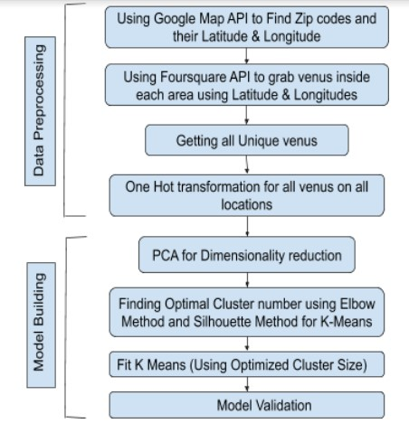
1.2 The Data: The Workflow

Slide 6
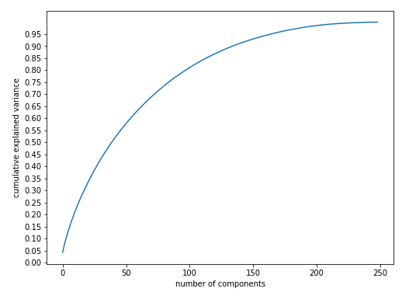
1.2.2. Selecting Principal Components

Slide 7
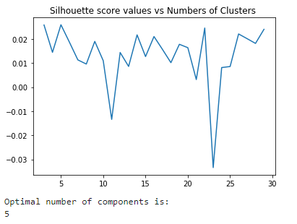
1.2.3. Silhouette Score

Slide 8
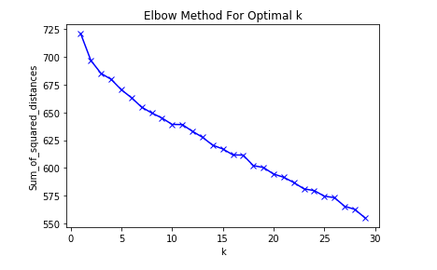
1.2.4. Elbow Method
Figure 4. Elbow found at k =5
(K is number of Clusters)

Slide 9
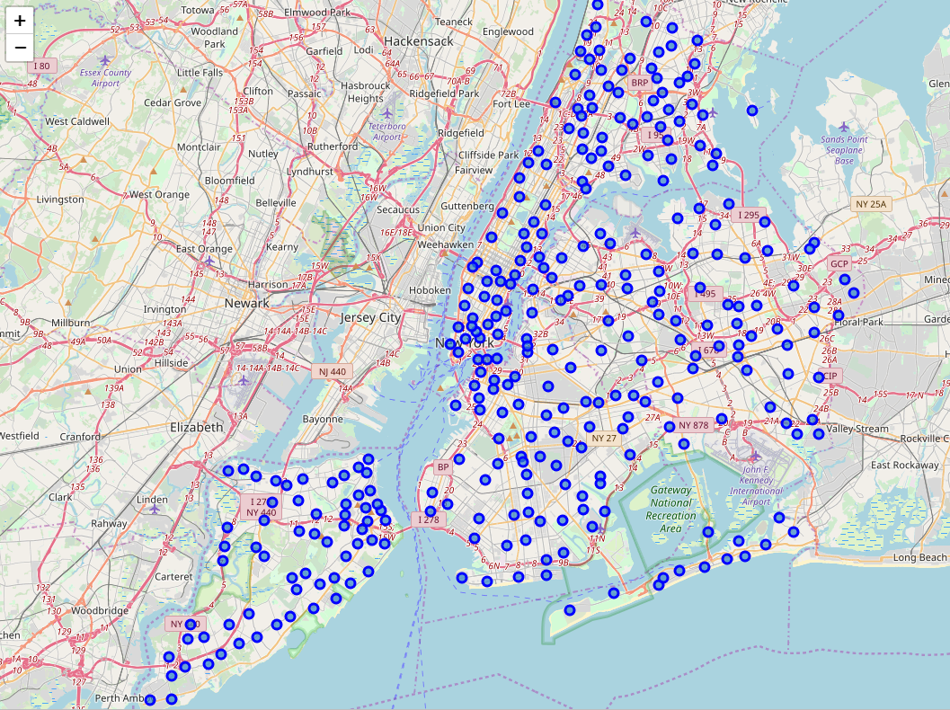
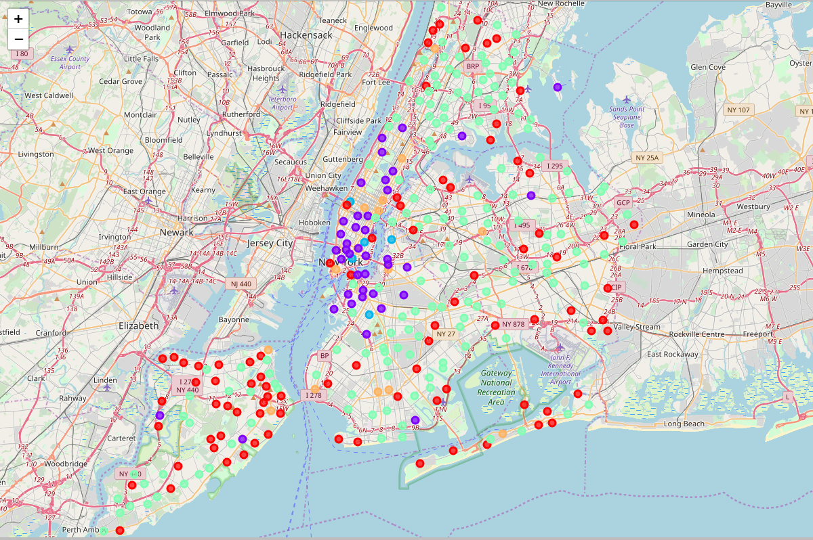
1.2.5. Cluster Visualization (1)
Before Clustering
After Clustering

Slide 10
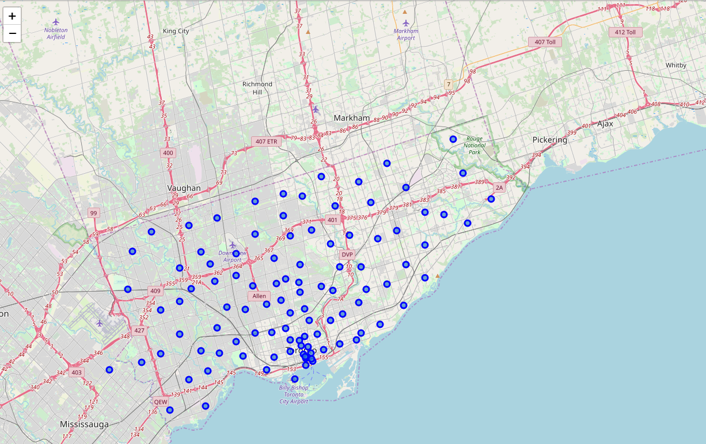
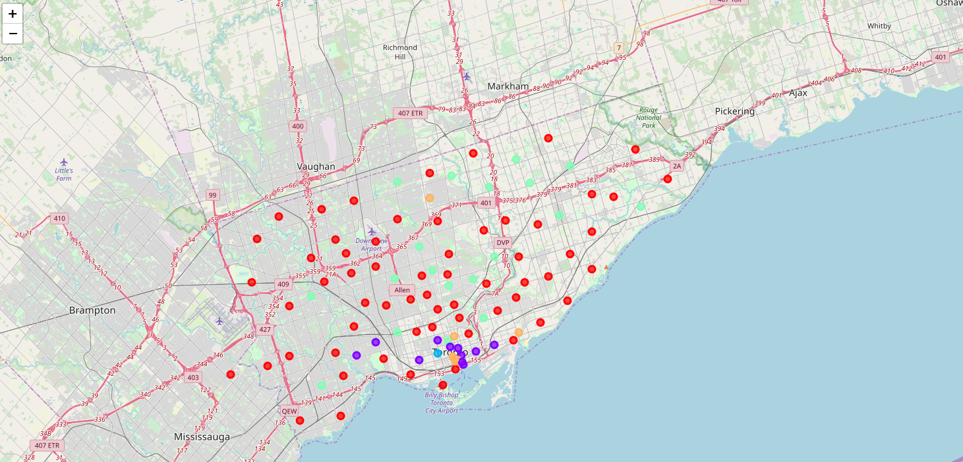
1.2.5. Cluster Visualization (2)
Before Clustering
After Clustering

Slide 11
3.Conclusion
The project work was only done on the zip codes of New York and Toronto, which includes 401 zip codes each having 150 features even after dimensionality reduction with PCA. The problem is that we have a huge feature space but limited number of samples. We can collect data from entire United States and Canada, which will make our dataset well balanced.
From figure 5 and 6, we can spot certain outlier in our data. In future we will try to filter out those outliers for more robust clustering.
There could be other clustering algorithms that can work better. In future, DBSCAN seems to be a good fit for our data.
We can sum everything, and convert to a neighborhood recommendation APP.

Slide 12
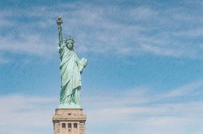
Thank you!

